Slide 1
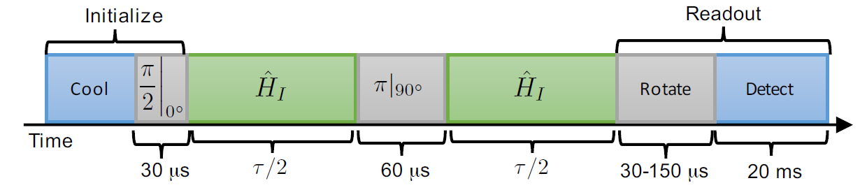
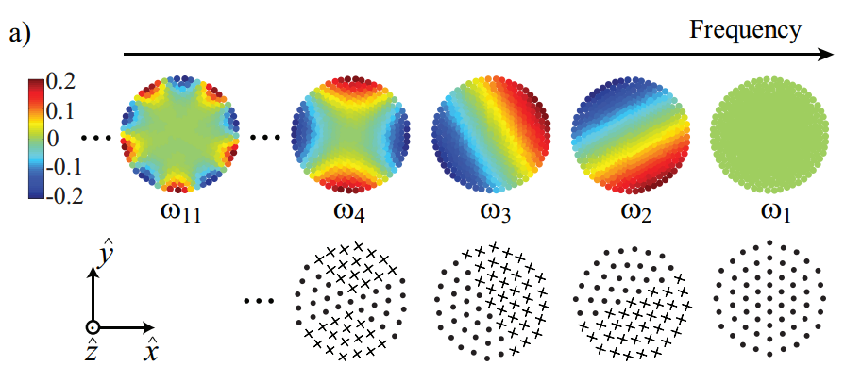
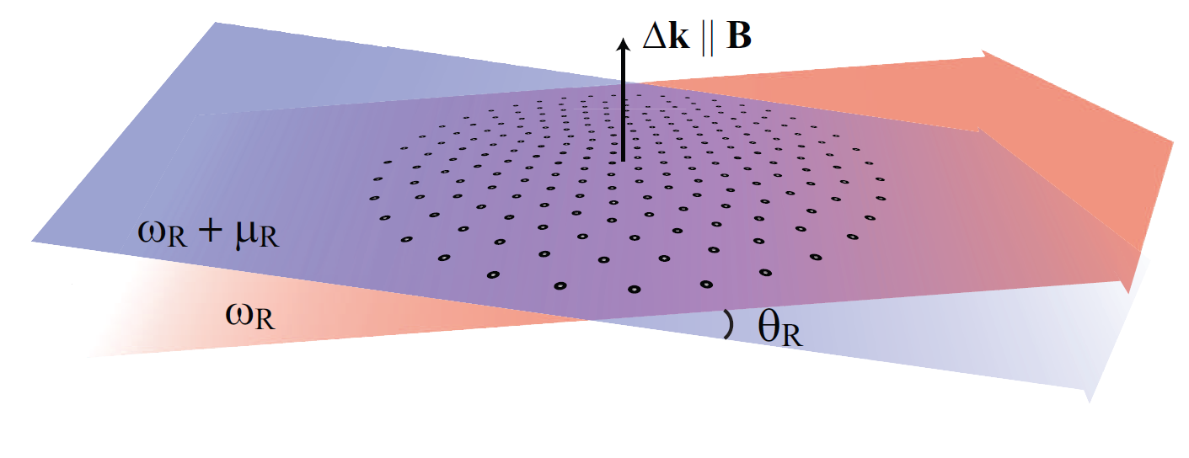
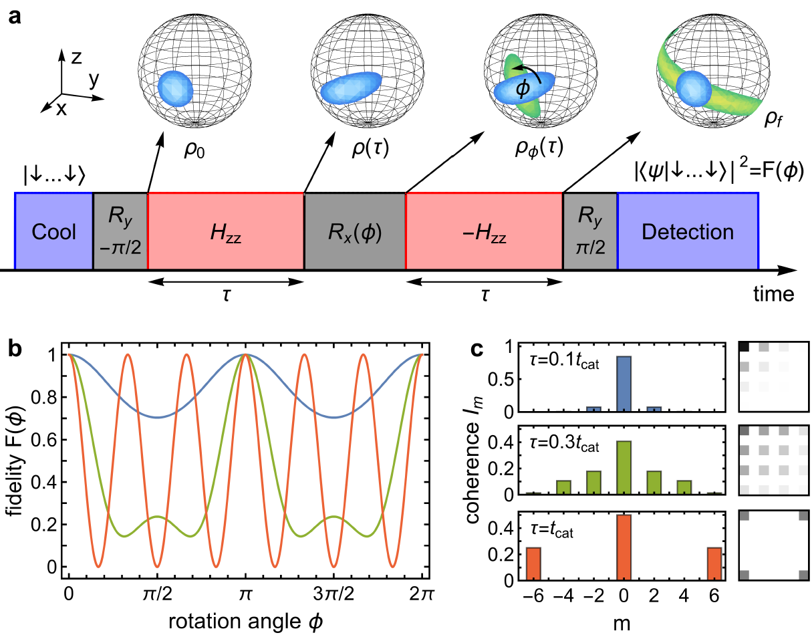
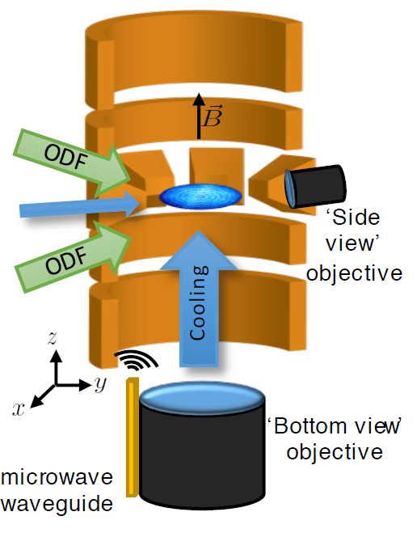
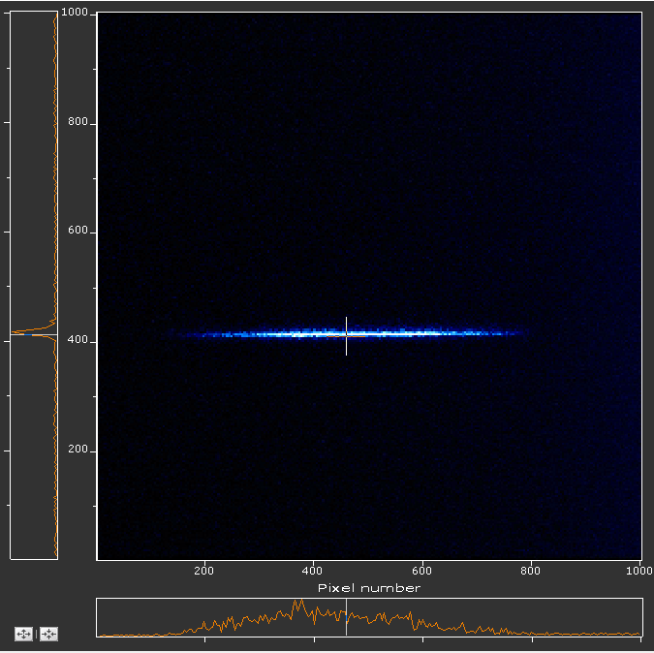
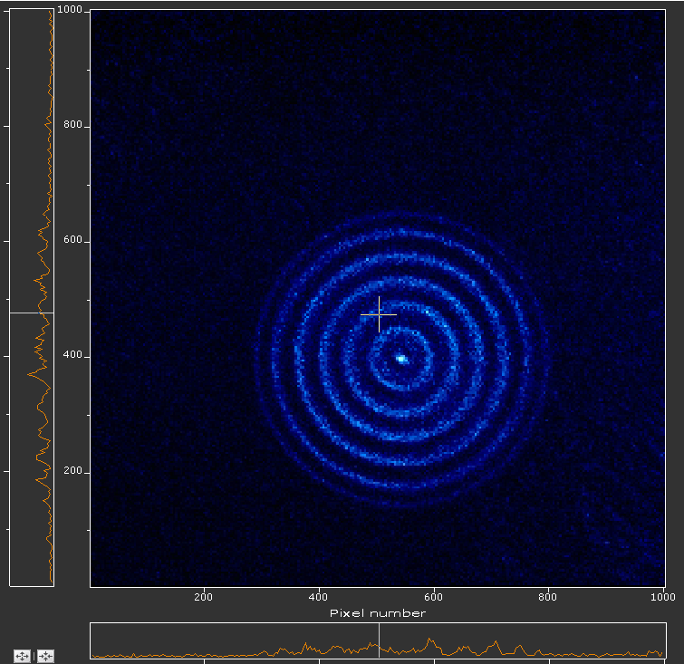
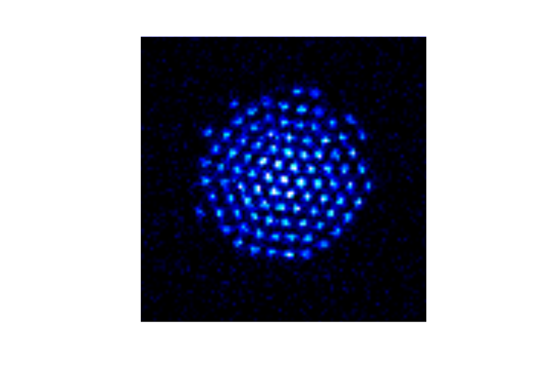
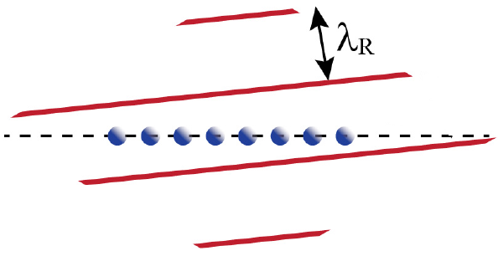
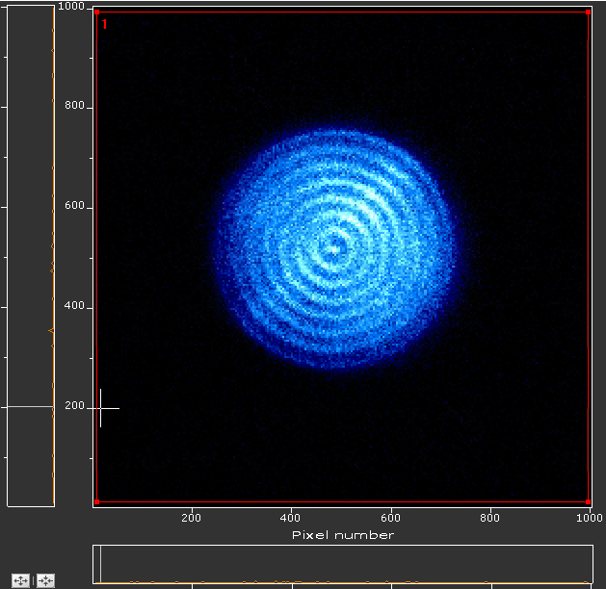
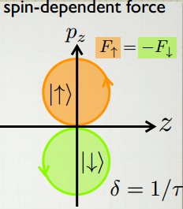
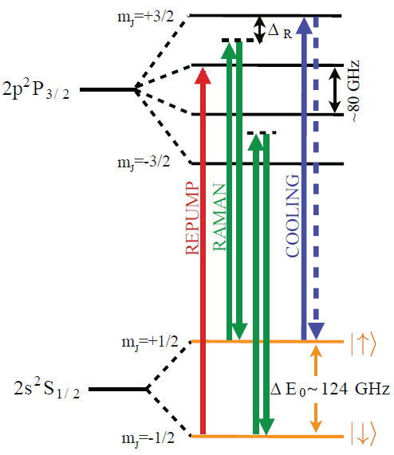
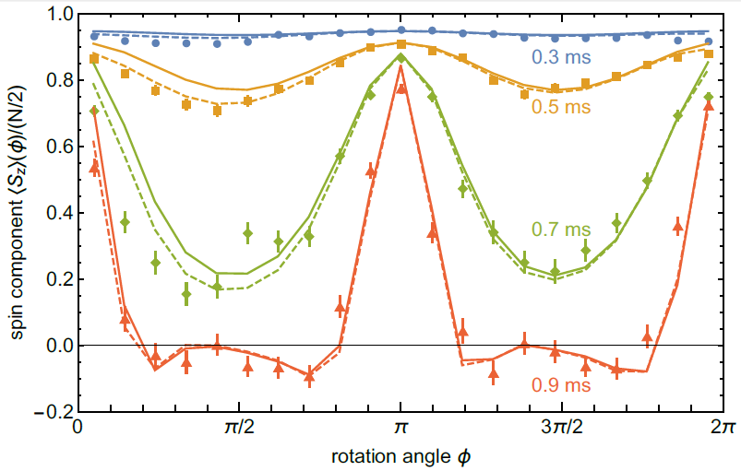
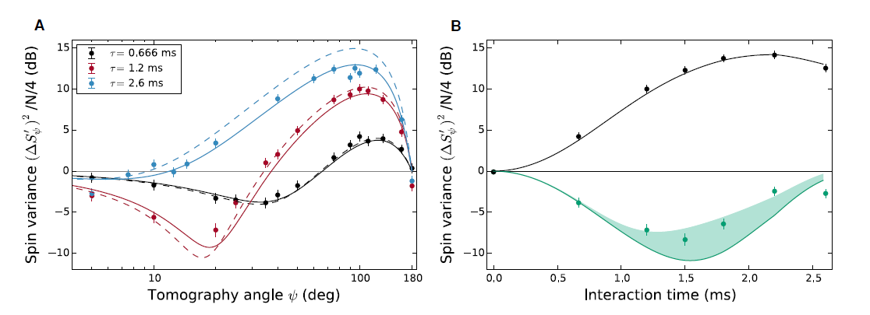
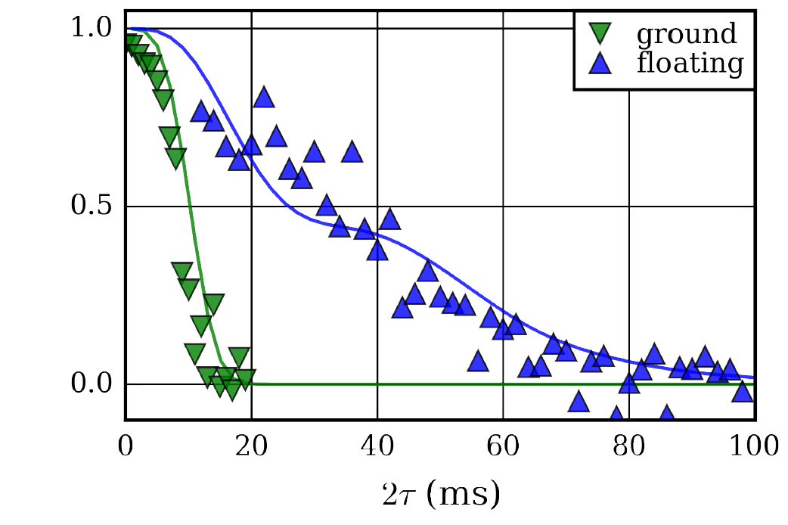
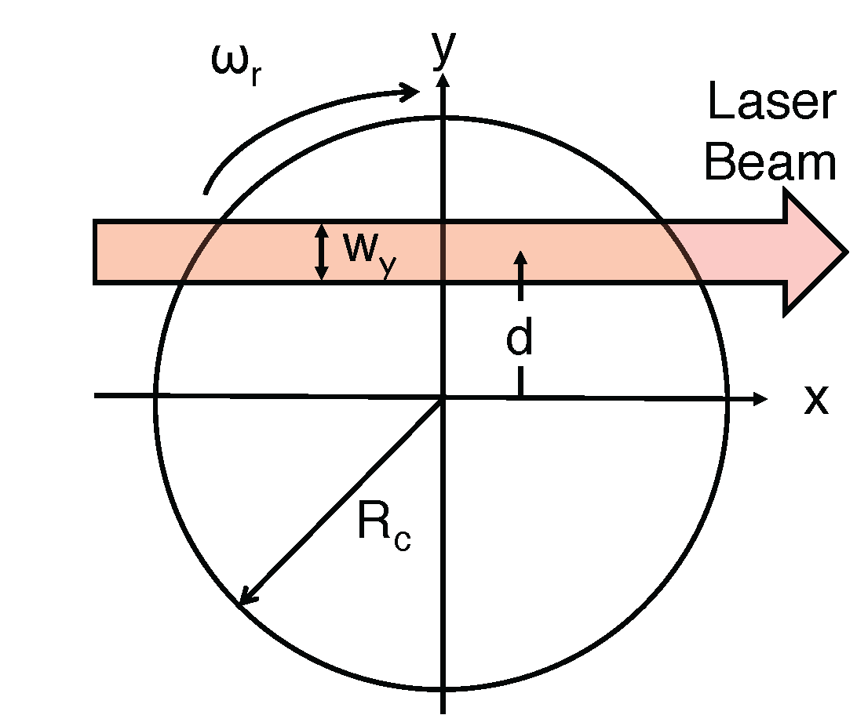
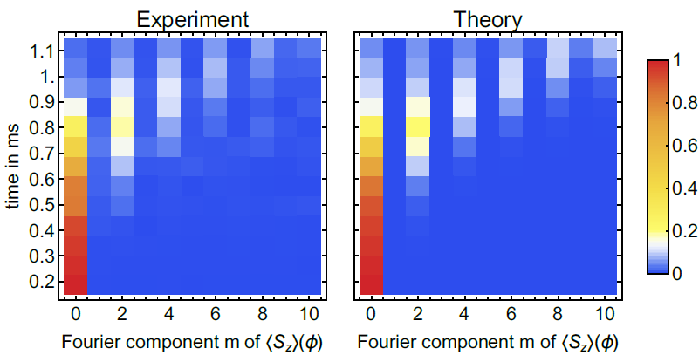
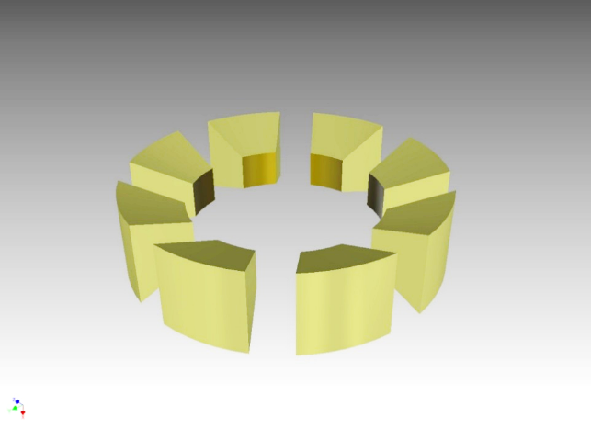
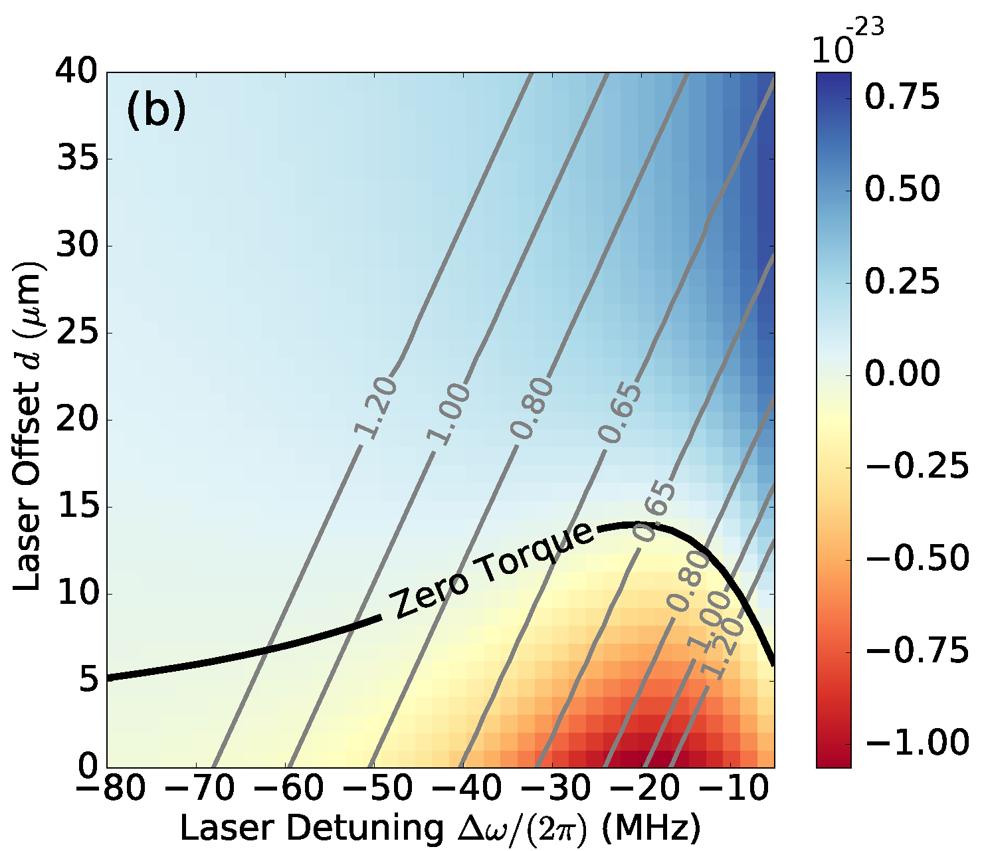
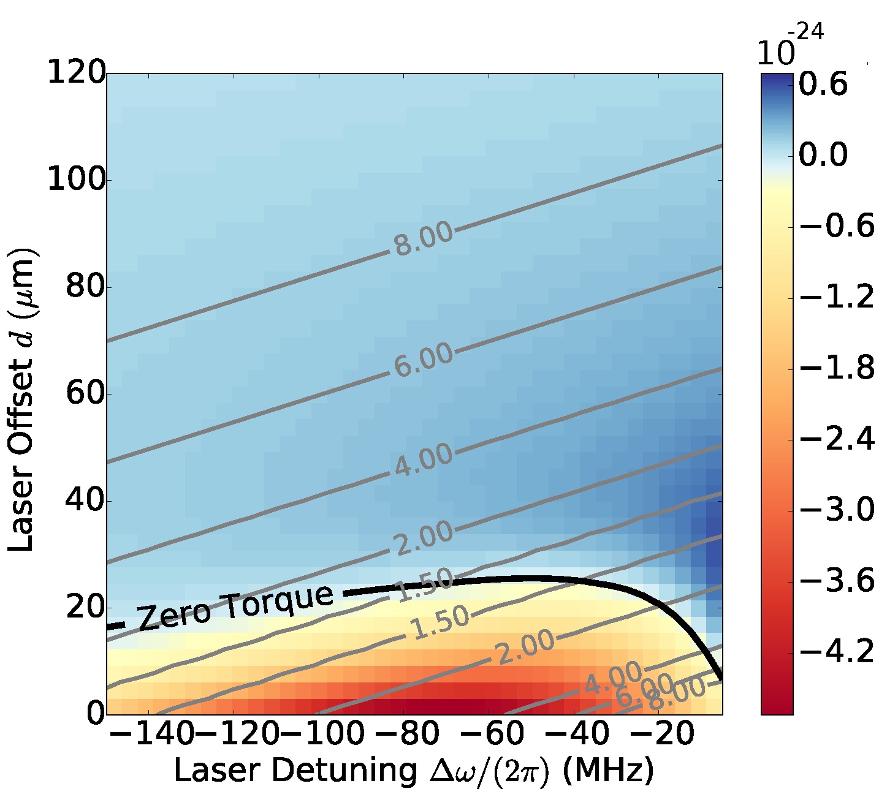
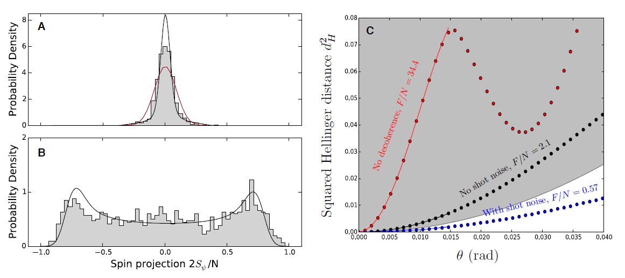
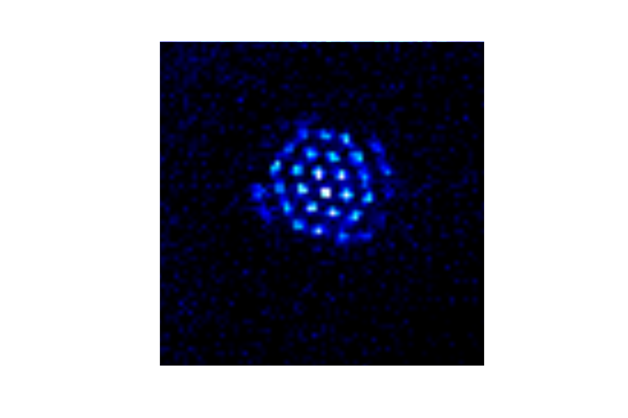
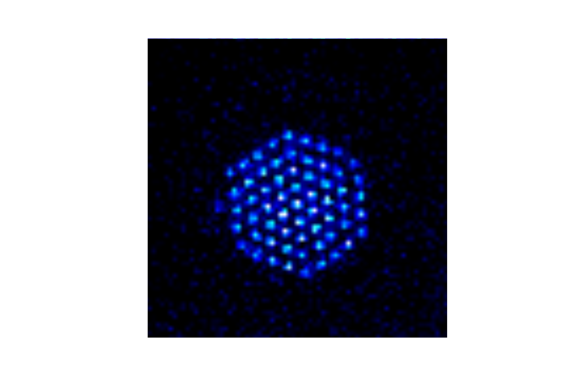
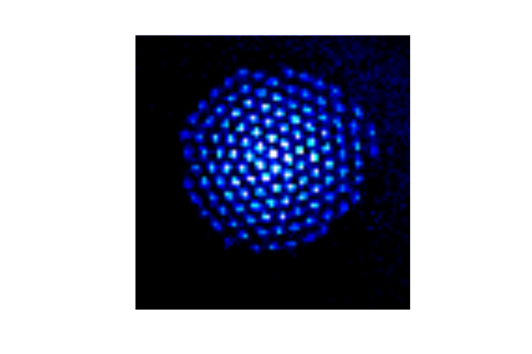




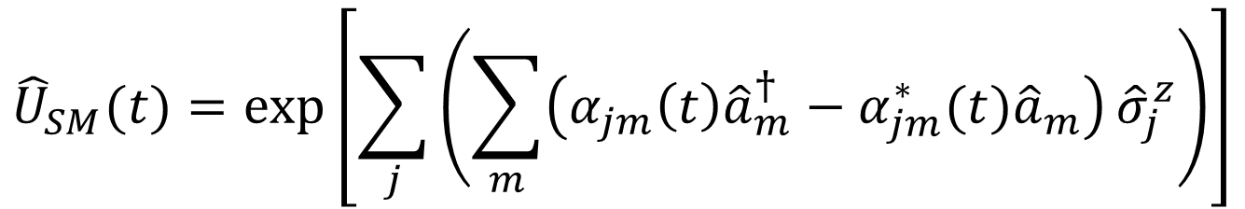
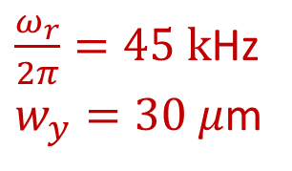
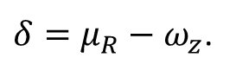
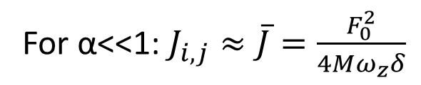
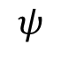
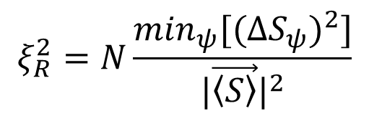
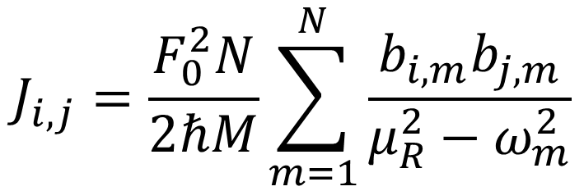
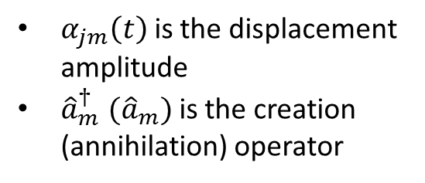
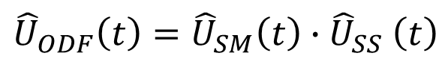
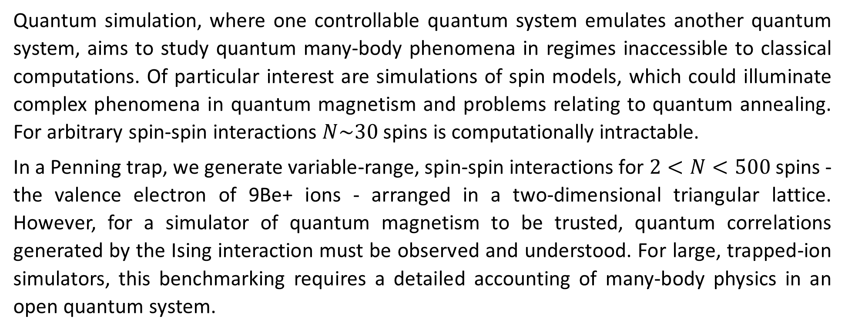
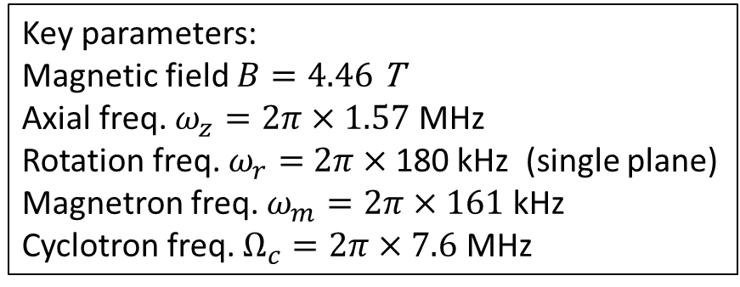
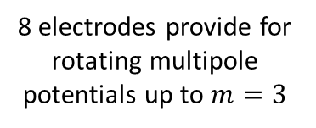
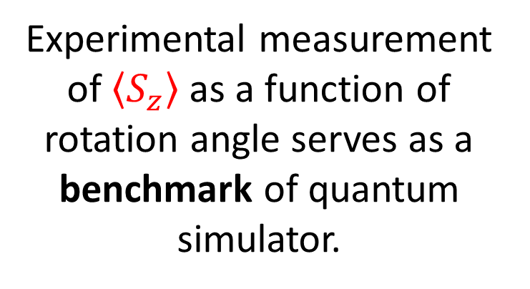
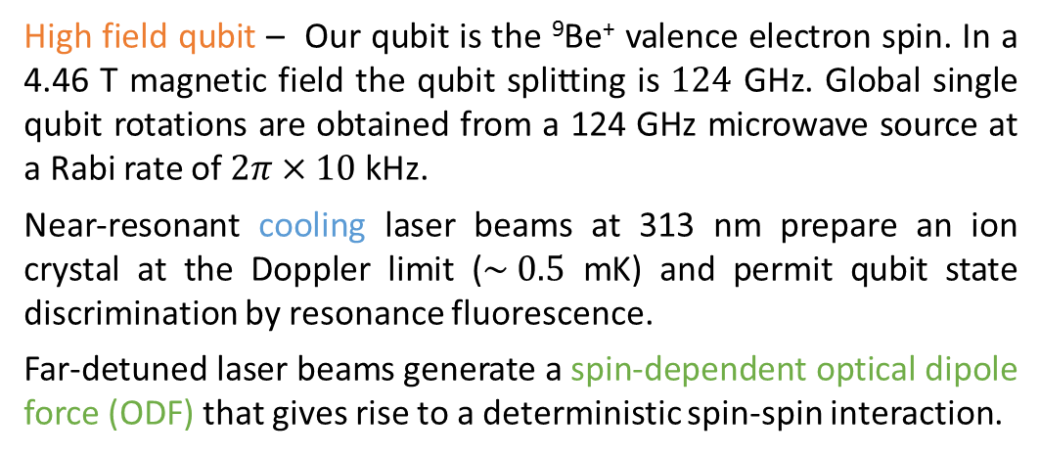
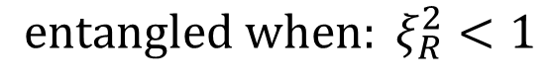
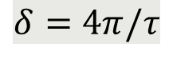

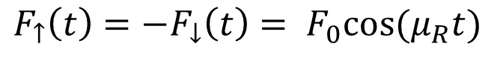
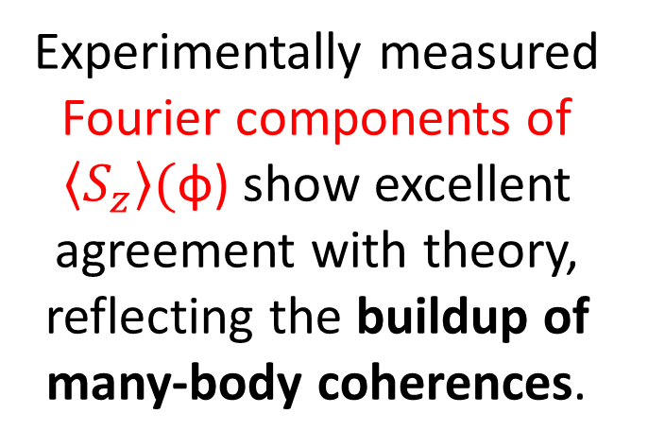
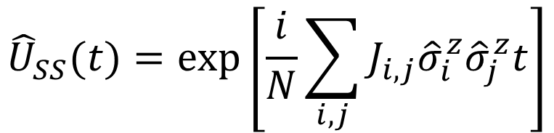
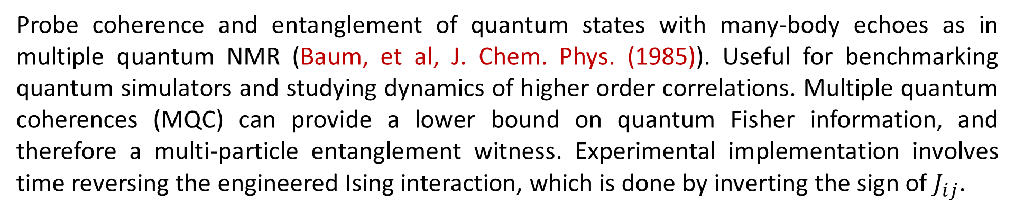
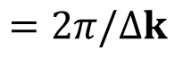
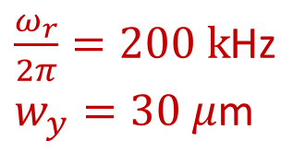
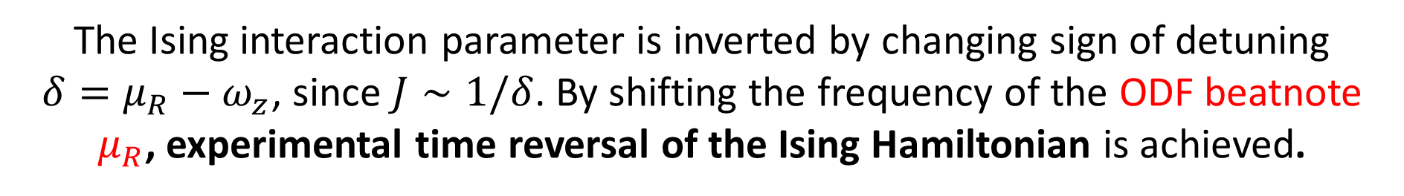
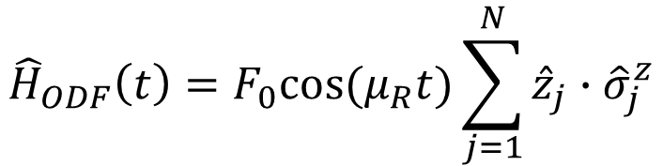
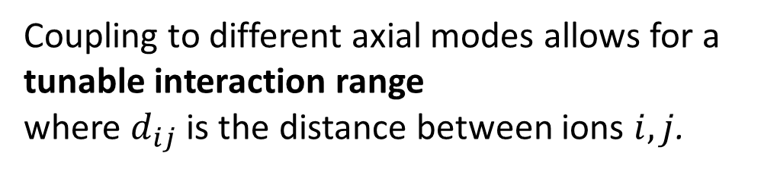
Motivation
Ising interaction with spin-dependent force
Spin squeezing and entanglement
Multiple quantum coherences
See M. Gärttner N4.00004
Quantum simulation, where one controllable quantum system emulates another quantum system, aims to study quantum many-body phenomena in regimes inaccessible to classical computations. Of particular interest are simulations of spin models, which could illuminate complex phenomena in quantum magnetism and problems relating to quantum annealing. For arbitrary spin-spin interactions $N\sim 30$ spins is computationally intractable.
In a Penning trap, we generate variable-range, spin-spin interactions for $2<N<500$ spins - the valence electron of 9Be+ ions - arranged in a two-dimensional triangular lattice. However, for a simulator of quantum magnetism to be trusted, quantum correlations generated by the Ising interaction must be observed and understood. For large, trapped-ion simulators, this benchmarking requires a detailed accounting of many-body physics in an open quantum system.
Two far-detuned laser beams produce a spin-dependent optical dipole force (ODF) at the ions that gives rise to a spin-spin interaction. Combined with a transverse magnetic field, we can realize non-trivial quantum magnetic interactions.
Bohnet, et al, arXiv:1512.03756 to be published in Science
Probe coherence and entanglement of quantum states with many-body echoes as in multiple quantum NMR (Baum, et al, J. Chem. Phys. (1985)). Useful for benchmarking quantum simulators and studying dynamics of higher order correlations. Multiple quantum coherences (MQC) can provide a lower bound on quantum Fisher information, and therefore a multi-particle entanglement witness. Experimental implementation involves time reversing the engineered Ising interaction, which is done by inverting the sign of $J_{ij}$.
Benchmarking of quantum correlations and many-body physics in an open quantum system.
Experimental measurement of Ising spin dynamics demonstrating entanglement by observing spin squeezing. Examine interplay between correlations and decoherence.
transverse B-field from
124 GHz microwaves
Coupling to different axial modes allows for a tunable interaction range
where $d_{ij}$ is the distance between ions $i, j$.
Engineered Ising interaction from
spin-dependent ODF
Overlap with initial state as a function of rotation angle yields oscillations from which the multiple quantum coherences are obtained.
Experiment pulse sequence, composed of cooling laser pulses (blue), microwave pulses (grey), and ODF laser pulses (green).
Experimental Details
Lab frame CCD images
Observe depolarization of the collective spin.
Distinguish destruction of correlations caused by decoherence from coherent depolarization caused by spin-spin interaction.
$$F_{↑}\left(t\right)=−F_{↓}\left(t\right)= F_{0}cos⁡(μ_{R}t)$$
$$J_{i,j}=\frac{F_{0}^{2}N}{2ℏM}\sum_{m=1}^{N}{\frac{b_{i,m}b_{j,m}}{μ_{R}^{2}−ω_{m}^{2}}}$$
Depolarization of the collective spin from spin-spin interactions and decoherence
Side view
$$=2π/Δk$$
Coherent Interactions
1D optical lattice wavefronts
spin-spin interaction
Coherent Ising interactions give rise to (over) squeezed state
For α<<1: $J_{i,j}≈\overline{J}=\frac{F_{0}^{2}}{4Mω_{z}δ}$
$$100 μm$$
$$100 μm$$
Spin-motion entanglement
See A. Safavi-Naini N4.00005
Bottom view
Rotating frame from timed single photon counts
$${\hat{H}}_{ODF}\left(t\right)=F_{0}cos⁡(μ_{R}t)\sum_{j=1}^{N}{{\hat{z}}_{j}{∙\hat{σ}}_{j}^{z}}$$
$${\hat{U}}_{ODF}\left(t\right)={\hat{U}}_{SM}\left(t\right){∙\hat{U}}_{SS}\left(t\right)$$
Decoherence
Key parameters:
Magnetic field $B=4.46$ T
Axial freq. $ω_{z}=2π×1.57$ MHz
Rotation freq. $ω_{r}=$ $2π×$180 kHz (single plane)
Magnetron freq. $ω_{m}=2π×161$ kHz
Cyclotron freq. $Ω_{c}=2π×7.6$ MHz
Decoherence leads to shortening of Bloch vector
$${\hat{U}}_{SM}(t)=\exp\left[\sum_{j}{\left(\sum_{m}{\left(α_{jm}\left(t\right){\hat{a}}_{m}^{†}−α_{jm}^{∗}(t){\hat{a}}_{m}\right)}{\hat{σ}}_{j}^{z}\right)}\right]$$
Spin-motion entanglement
Decoherence in Bloch vector
Metrological tool
Large term for small detunings
Idealized fidelity signal for different evolution times τ.
Fourier transforms of the fidelity signals. The Fourier amplitudes are identical with the multiple quantum coherences.
⁹Be⁺ qubit system
High field qubit – Our qubit is the ⁹Be⁺ valence electron spin. In a 4.46 T magnetic field the qubit splitting is $124$ GHz. Global single qubit rotations are obtained from a 124 GHz microwave source at a Rabi rate of $2π×10$ kHz.
Near-resonant cooling laser beams at 313 nm prepare an ion crystal at the Doppler limit ($\sim 0.5$ mK) and permit qubit state discrimination by resonance fluorescence.
Far-detuned laser beams generate a spin-dependent optical dipole force (ODF) that gives rise to a deterministic spin-spin interaction.
$α_{jm}\left(t\right)$is the displacement amplitude
${{\hat{a}}_{m}^{†} (\hat{a}}_{m})$is the creation (annihilation) operator
$$δ=4π/τ$$
Plot: Contrast decay for N = 21, 58, and 144 ions (black circles, red squares, and blue diamonds). Black squares show contrast decay from decoherence due to spontaneous emission in the absence of spin-spin coupling.
The Ising interaction parameter is inverted by changing sign of detuning
$δ=μ_{R}−ω_{z}$, since $J∼1/δ$. By shifting the frequency of the ODF beatnote $μ_{R}$, experimental time reversal of the Ising Hamiltonian is achieved.
Residual spin-motional entanglement leads to shortening of the Bloch vector and is minimized at certain drive times for a given detuning,
Measure and benchmark modification of collective spin variance
and verify entanglement using spin-squeezing.
$${\hat{U}}_{SS}(t)=\exp\left[\frac{i}{N}\sum_{i,j}{J_{i,j}{\hat{σ}}_{i}^{z}{\hat{σ}}_{j}^{z}t}\right]$$
Spin-spin coupling
Ising interaction
Dominant for large detunings
T2 Coherence time
$δ=μ_{R}−ω_{z}$.
Experimental measurement of $\left\langle S_{z}\right\rangle$ as a function of rotation angle serves as a benchmark of quantum simulator.
In the Penning trap, we realize the effective Ising Hamiltonian at specific decoupling points, where the spin-motion entanglement is eliminated.
Fringe Contrast
Perpendicular laser cooling with a rotating wall
Torrisi, Britton, Bohnet, Bollinger, PRA 93 (2016)
For future implementation of single spin state readout, low in-plane temperatures with minimal torques on the crystal are needed for improved crystal stabilization.
2-D geometry for
perpendicular laser cooling
N = 86 ± 2. Dashed lines are predictions assuming homogenous Ising interactions. Solid lines include decoherence from spontaneous emission.
Minimum (green points) and maximum (black points) spin variance
Evolution time (ms)
$$ξ_{R}^{2}=N\frac{\min_{ψ}[(ΔS_{ψ})^{2}]}{|\vec{\left\langle S\right\rangle }|^{2}}$$
Experimentally measured Fourier components of $\left\langle S_{z}\right\rangle ($φ) show excellent agreement with theory, reflecting the buildup of many-body coherences.
Britton et al., arXiv_1512.00801, to be published in PRA
Account for energy exchange with a rotating wall:
Low in-plane temperatures more readily achievable with a rotating wall than without.
$$ψ$$
$${entangled when: ξ}_{R}^{2}<1$$
Controlling 2D crystals with rotating potentials
We apply a controlled torque to the ion crystal using a weak ‘rotating wall’ potential. This radially asymmetric potential is produced using split ring electrodes at the axial trap center. Controlling the rotation frequency stabilizes the radial trapping potential, producing stable ions crystals in a well-defined rotating frame.
Rotating wall provides an energy sink for the work done
by the perpendicular beam in applying a torque.
Observe non-Gaussian counting statistics in collective spin state.
Disappearance of spin-squeezing at long times consistent with formation of over-squeezed state - not just degradation due to decoherence.
Contours of equilibrium temperature (mK) with a color plot of the perpendicular laser torque (Joules)
Theory by M. Wall
MQC spectrum shows the time dynamics of many-body correlations in the ensemble, even acting as an entanglement witness for n-body entanglement.
8 electrodes provide for rotating multipole potentials up to $m=3$
$\frac{ω_{r}}{2π}=45 k$Hz
$w_{y}=30 μ$m
$\frac{ω_{r}}{2π}=200 k$Hz
$w_{y}=30 μ$m
Future Directions
Transverse magnetic field, with variable range spin-spin interactions
Sensitive force detection
Apply sub-Doppler cooling (EIT) to the axial drumhead modes
Implement single-ion resolved readout
50 μm
N=25
N=61
N=91
N=124
50 μm
Images of different single-plane crystals in the rotating frame.
Composed of data from 1-2 seconds of integration.
Full counting statistics of a non-Gaussian spin state and theoretical Fisher information (F). Histograms showing
the (A) squeezed and (B) anti-squeezed quadratures of the collective spin of N = 127 ± 4 ions.
Acknowledgements:

